Slide 1
MUNICIPAL BUDGET 2024
Municipality of Grosse Ile

Slide 2
The PROCESS
THE PROCESS
ESTABLISH PRIORITIES
Discussion by members of council and preparation of draft
ADOPTION &
PUBLICATION
Presentation of final document and adoption
PRESENT
DRAFT
Presentation of draft, feedback and completion of final document

Slide 3
Maintaining a balanced budget
Vigilant
Effective cost management
Responsible
Adjust tax rates as needed to maintain a balanced budget from year to year
Resourceful
Seek alternative sources of revenue
Prioritize investment projects

Slide 4
2024 ORIENTATIONS
Municipal Park
Prioritize what needs to be done to finalize Phase II of the intergenerational community park
Roads
Realize Phase I of Rock Mountain and Wide Road project
Maintenance
Ensure sufficient funds to carry out essential maintenance and repairs to municipal infrastructure

Slide 5
TAXES AND EVALUATION
TAX RATES
Residential 1.35 1.35 1.35
Growth
Moderate growth in tax revenue representing 7% in 2024 due mainly to an increase in the industrial value.
Non-residential 2.66 2.66 2.66
Industrial 2.94 2.94 2.94
Increase
Increase of government transfers in 2024 totaling $65,870 vs 2023 budget.
2024 2023 2022

Slide 6
OPERATING EXPENSES
Inflation
Has a big impact on all operating expenses at the municipality as anywhere else.
Leisure and Culture
The gymnasium floor has been replaced in 2023, therefore this expense is not renewed in 2024’s budget.
Administration
Note that the negotiation of the union book will be done next fall and may have impact on 2025’s budget.
Investment
The Council will invest money (without raising taxes) to continue to improve the quality of the municipality services and installations.

Slide 7
BUDGET COMPARISON
REVENUE –$ 1,230,000 2024 2023
EXPENSES (Operations $1,047,340) 2024 2023
Administration $608,900 $533,410
EXPENSES (Capital $182,660) 2024 2023
Reimbursement of long-term debt $ 32,660 $ 43,690
Urban Planning & Development $ 52,100 $ 34,100
Investment activities $150,000 $100,000
Public Security $ 35,912 $ 33,811
Public Roadways $155,300 $155,269
Leisure and Culture $180,527 $273,020
Financing $ 14,600 $ 6,700
Taxes $810,186 $756,732
Transfers $238,658 $171,788
In-lieu of taxes $ 42,157 $ 42 543
Cost sharing $ 15,000 $ 25,000
Services rendered $ 57,999 $ 45,362
Affectations $ 50,000 $121,576
Other $ 16,000 $ 17,000

Slide 9
INVESTMENTS
MUNICIPAL PARK
Completion of Phase II of the intergenerational community park
ROADS
Call for tenders and realize Phase I of Rock Mountain and Wide Road
Capital spending
Financing for capital investments are obtained mainly from grants and loans, when needed and prioritized, accumulated surplus (affectations) are used. Therefore, capital spending of 2024 has a minimal impact on the tax rates.
ADDITIONS TO THE TRIENNIAL CAPITAL PLAN
 | Estimate | Grant | Net Cost | Source
Roadworks –Wide & Rock Mountain | $1,031,240 | $872,041 | $159,199 | Loan
Phase II - Park | $150,000 | $100,000 | $50,000 | Acc. surplus
TOTAL | $1,181,240 | $972,041 | $209,199

Slide 10
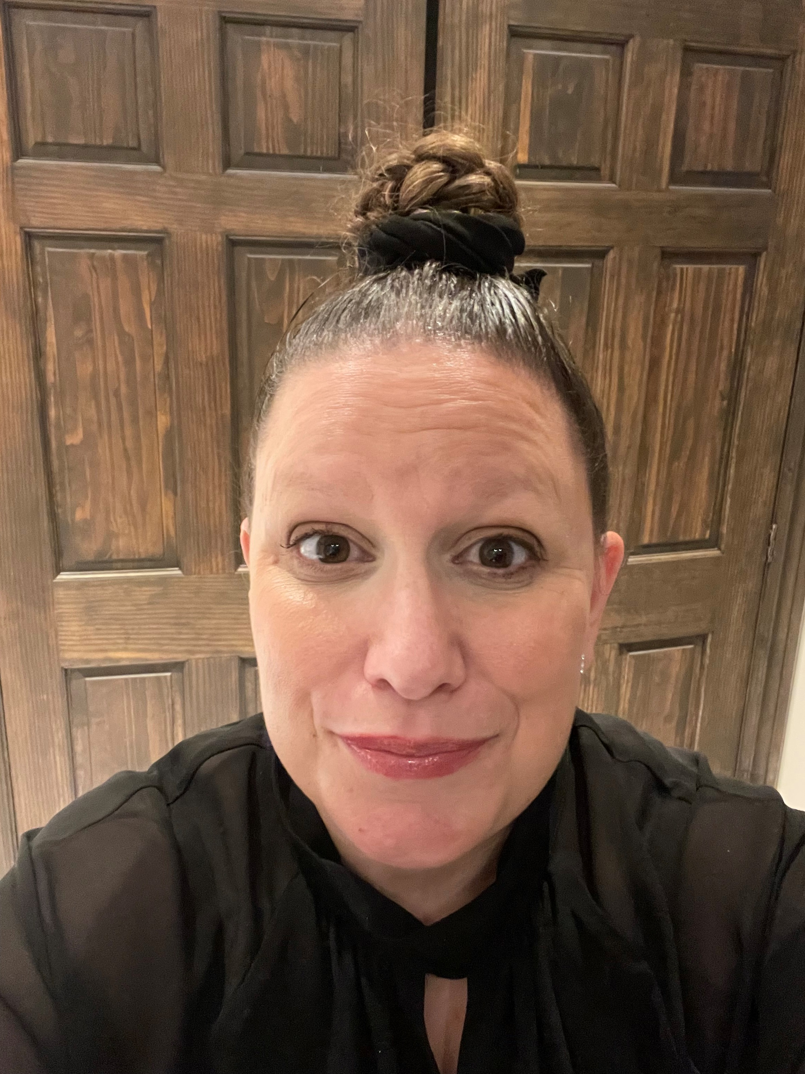
Happy Holidays from the members of council and staff of the Municipality of Grosse Ile! You can reach the Interim General Director Carole Lemieux, CPA at: 418 985-2510 ext. 223 direction@mungi.ca

